Slide 1
Early Student Intervention Student Attendance Indicator
Nicholas Stirling
Bellevue University
DSC630 – Predictive analytics
Professor Frank Neugebauer
Notes:
Today I’ll present a predictive modeling project focused on identifying students at risk of low attendance. The goal was to evaluate whether machine learning could support early intervention in a university setting while maintaining ethical safeguards.

Slide 2
Effective and Efficient Support
Student attendance is a leading indicator of academic performance, engagement, and long-term retention
Early identification and intervention could lead to improvement in student outcomes and institutional efficiency
Predictive modeling decision support tool offers:
Efficient advisor outreach
Potential tutoring needs
Identification of student support opportunities
Notes:
Declining attendance is often an early indicator of academic difficulty impacting both student engagement and long-term retention. However, institutions typically respond reactively once it is already difficult to change outcomes. Early identification of at-risk students could lead institutions to boost student outcomes which will improve both graduation rates and institutional efficiency. This project explores whether we can identify risk earlier using structured data and predictive modeling. Successful predictive modeling decision support tools could create more efficiencies in advisor outreach, identifying students who need tutoring opportunities and tutoring demand, as well as broader student support opportunities for resource allocation.

Slide 3
Project Objective
Build a predictive model to identify students with low attendance risk
Evaluate operational feasibility through evaluation and threshold tuning
Assess potential ethical implications of deployment
Notes:
This was not just a modeling exercise. The goal was to evaluate model feasibility, operational practicality, and ethical considerations in a real-world deployment context.

Slide 4
Training Dataset
Synthetic student attendance data with predictive categories including:
Behavioral (study hours)
Logistical (travel time)
Demographic (age, school type)
Engagement (Extracurricular activities, internet access)
Source: Student Performance Dataset. Kaggle.com. https://www.kaggle.com/datasets/kundanbedmutha/student-performance-dataset?resource=download
Notes:
The dataset was a publicly available synthetic student attendance dataset which included behavioral, logistical, and demographic variables. In reviewing the data set it was identified as attendance declined below 80% there was a steady increase in probability of low academic performance. Based off these findings the target variable was set to indicate whether a student was at risk of low attendance. Importantly, this was a binary classification problem focusing on identifying student as at-risk or not at-risk of low attendance.

Slide 5
Data Preparation
Categorical variables were encoded for model interpretation(gender, school type, parent education, internet access, extra activities, study method)
Travel Time encoded buckets (<15 min,15-30 min, 30-60 min, >60 min)
80/20 Training/Test Split
Class Imbalance treatment
Notes:
To ensure there was no target variable leakage, academic outcomes were removed from the dataset as well as several demographic categories such as gender to reduce bias and ethical concerns. Preprocessing included encoding categorical variables and ensuring all model inputs were numeric. An 80/20 training/test split was used. Class imbalance was identified with high attendance being the majority of identified students. To prevent training bias class weights were applied to prevent majority-class bias by penalizing misclassification of at-risk students more severly.

Slide 6
Modeling Approach
Logistic Regression
Baseline linear model
Interpretable baseline
Random Forest
Nonlinear ensemble model
Captures nonlinear relationships & interactions
Notes:
I compared a linear baseline model with a nonlinear random forest ensemble method. Logistic regression provides interpretability and would create a baseline but assumes linear relationships. To further develop predictive analysis Random Forest captures nonlinear interactions and complex patterns between predictor variables.

Slide 7
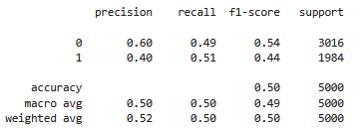
Logistic Regression Results
Notes:
The logistic regression model performed no better than random chance showing a recall, which was the prioritized evaluation metric, of .51. Similarly, the highest identified coefficient factor was only 0.013, suggesting minimal explanatory value for attendance decline. This indicates that linear relationships alone do not adequately explain attendance risk in this dataset.

Slide 8
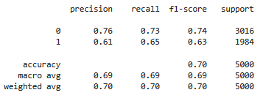
Random Forest Results
Notes:
Further evaluation with Random Forest significantly outperformed the linear model. An AUC of 0.75 indicates meaningful discrimination. The model correctly identified approximately 65% of at-risk students at the default threshold. This confirmed the presence of non-linear relationships among the predictors.

Slide 9
Modeling Classification Evaluation
Logistic Regression
Random Forest
True Positive
1481
False Negative
1535
True Positive
2196
False Negative
820
False Positive
978
True Negative
1006
False Positive
693
True Negative
1291
Notes:
For early warning systems, recall is critical—we want to identify struggling students. However, improving recall increases false positives. This tradeoff becomes central in deployment decisions. We can see a significant increase in True positives (at-risk correctly identified) from logistic regression to random forest models. This comes with a decrease in false positive and false negative identification as well overall increase in model accuracy. False positives (students flagged unnecessarily) being of particular importance in operational deployment as efficient use of resources becomes a priority. This is why the focus on recall; the correct identification of all positive cases is the priority for evaluation even at the risk of decreased precision. This target also clearly places this tool as a screening tool and not a diagnostic tool that should indicate certainty in identification.

Slide 10
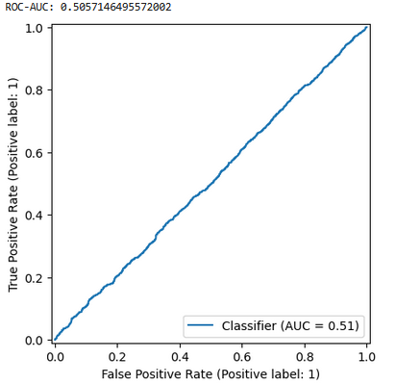
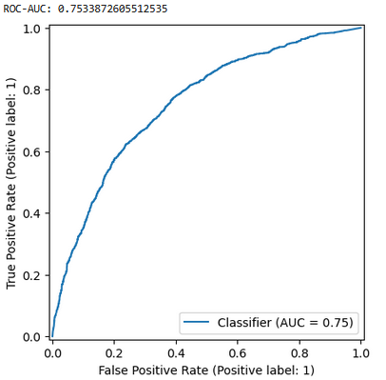
ROC Curve
Logistic Regression
Random Forest
Notes:
Logistic ~ diagonal (random chance)
Random forest above baseline
Dataset contains predictive structure, but it is nonlinear
The ROC curve comparison confirms that nonlinear modeling captures predictive structure missed by the linear model. Logistic Regression shows a approximately diagonal ROC Curve with Random Forest well above the baseline. This supports that the dataset contains predictive structure that is non-linear in nature. Model selection materially impacts outcomes and is critical for success.

Slide 11
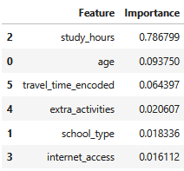
Identified Key Features
Notes:
Behavioral engagement—specifically study hours—was by far the dominant predictor with a 79% importance. Demographic factors, such as age, as well as additional factors such as travel time and extra activities played a minimal role. This suggests behavioral engagement monitoring may be more impactful than static demographic profiling. Intervention strategies should be focused on these engagement patterns as well to influence uptake and impact.

Slide 12
Threshold Tuning: Why It Matters
Default Threshold = .50
Early warning prioritizing recall
Threshold selection impacts intervention volume and can refine operational goals
Notes:
Classification models default to a 0.50 probability cutoff. However, institutions may prioritize detecting as many at-risk students as possible maximizing recall in alignment with an early warning tool or decision threshold for at-risk identification could be increased due to constrained resources. Threshold tuning aligns model output with institutional objectives and resources allowing for the model to be implemented across institutions and be functional as circumstances change.

Slide 13
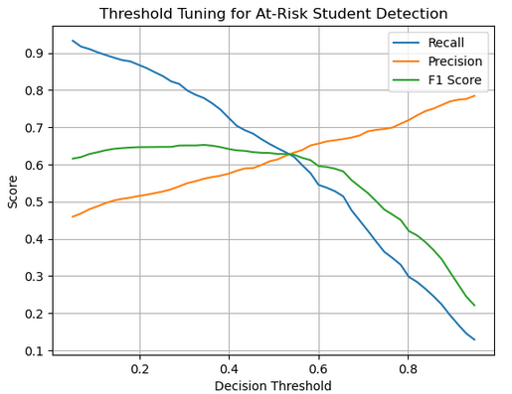
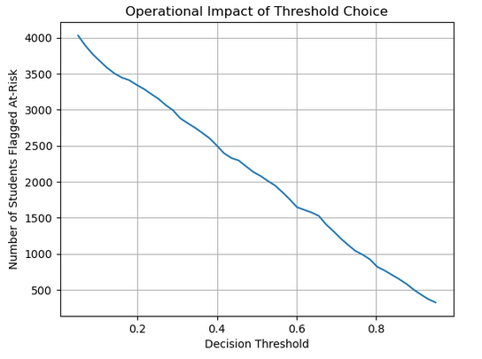
Threshold Tradeoff Results
Recall vs Precision Curve
Students Flagged vs Threshold
Notes:
Focusing on higher recall increases students flagged as at-risk increasing potential intervention opportunities and resource demands. Through evaluating performance across several threshold we were able to identify that model effectiveness was demonstrated across a wide array of thresholds. At a threshold of approximately 0.34, the model achieved nearly 78% recall without a significant decrease in precision. This demonstrates that high detection is possible without extreme over-classification.

Slide 14
Operational Simulation
 | Early Warning Focus | Balanced Performance | Efficiency Focus
Threshold | 5% | 34.4% | 36.2%
Accuracy | 53.8 | 67.1 | 67.4
Precision | 45.9 | 56.2 | 56.6
Recall | 93.2 | 77.9 | 76.5
F1 | 61.6 | 65.3 | 65.1
Students Flagged | 4029 | 2751 | 2680
Notes:
Model Metrics can be adjusted to refine the model outputs to align with advising and intervention workload with institutional capacity. Operational deployment requires balancing detection rates with advising capacity. Threshold choice directly determines how many students will receive outreach. We can see here adjustment of the threshold based on institutional approach on the test population creating an early warning focus identifying 4029 students or an efficiency focus decreasing the population of at-risk students of 2680.

Slide 15
Ethical Consideration
Algorithmic Bias
Student labeling and false positives
Transparency and explainability
Governance & misuse
Notes:
While the Random Forest model demonstrated meaningful predictive capability, operationalizing its use must be carefully governed to prevent unintended harm. Models may unintentionally encode structural inequities. Factors such as study hours, travel time, or access to resources may correlate with socioeconomic conditions rather than student motivation alone. Predictions must be used only for supportive outreach, not punitive measures. Student labeling could create stigma, unnecessary monitoring, or reduce student trust if predictions are interpreted as judgments rather than risk indicators. This reinforces the need to frame the outputs as strictly decision-support signals to guide voluntary outreach and resource allocation, not disciplinary or evaluative actions. Transparency and explainability also present ethical obligations. Tree-based ensemble models, while more accurate than linear approaches in this effort, are less inherently interpretable. Clear communication about which data are being used, how predictions are generated, and how the results are used to inform interventions is required.

Slide 16
Model Limitations
No longitudinal attendance history
Limited contextual/socioeconomic variables
Cross-sectional dataset
Potential measurement error
Notes:
Despite these promising results, the model is not yet suitable for full automation. Limitations include the absence of longitudinal attendance history, limited contextual socioeconomic variables, and reliance on a single cross-sectional dataset. Additionally, ethical considerations—particularly bias risk, false positives, and governance of model use—necessitate cautious implementation with strong institutional safeguards.

Slide 17
Operationalizing Recommendations
Use model as screening support tool only
Prioritize recall-oriented thresholds
Incorporate longitudinal & contextual features
Conduct bias audits before deployment
Maintain human-in-the-loop oversight
Notes:
I recommend deploying this model only as a decision-support tool with human oversight. Thresholds should reflect institutional capacity and ethical considerations. Additional longitudinal and contextual features available should be added to enhance predictive value. Continued governance and audits is important to ensure continued effectiveness and fairness.

Slide 18
Conclusion
Predictive Modeling is a feasible support-tool
Engagement behaviors are the risk drivers
Ethical safeguards are required for effective implementation
Notes:
In conclusion, predictive modeling can meaningfully support early attendance intervention with model choice being key for success. However, successful implementation requires thoughtful threshold selection, ethical safeguards, and continued data refinement. This is a strong start to development, but continued development and refinement would be required for deployment with structured governance.

